Slide 1
Module 2
Corporate Strategies & their Marketing Implications
By: Dr Shahinaz Abdellatif

Slide 2
Objectives of the Session
To consider the corporate and business level context of marketing strategy

Slide 3
Guidelines for Market-Oriented
Management (1 of 2)
1. Create customer focus throughout the business.
2. Listen to the customer.
3. Define and nurture your distinctive competence.
4. Define marketing as market intelligence.
5. Target customers precisely.
6. Manage for profitability, not sales volume.
7. Make customer value the guiding star.
8. Let the customer define quality.
Notes:
11

Slide 4
Guidelines for Market-Oriented
Management (2 of 2)
9. Measure and manage customer expectations.
10. Build customer relationships and loyalty.
11. Define the business as a service business.
12. Commit to continuous improvement and innovation.
13. Manage culture along with strategy and structure.
14. Grow with partners and alliances.
15. Destroy marketing bureaucracy.
Notes:
12

Slide 5
Production-Oriented v’s Market-
Oriented Organizations (1 of 2)
Business activity or
function
Product offering
Product line
Pricing
Research
Production orientation
Company sells what it can
make; primary focus on functional performance and cost.
Narrow.
Based on production and distribution costs.
Technical research; focus on product improvement and cost cutting in the production process.
Marketing orientation
Company makes what it can sell; primary focus on customers’ needs and market opportunities.
Broad.
Based on perceived benefits provided.
Market research; focus on identifying new opportunities and applying new technology to satisfy customer needs.
Notes:
13

Slide 6
Production-Oriented v’s Market-
Oriented Organizations (2 of 2)
Business activity or
function
Packaging
Credit
Promotion
Production orientation
Protection for the product; minimize costs.
A necessary evil; minimize bad debt losses.
Emphasis on product features, quality, and price.
Marketing orientation
Designed for customer convenience; a promotional tool.
A customer service; a tool to attract customers.
Emphasis on product benefits and ability to satisfy customers’ needs or solve problems.
Notes:
14

Slide 7
What does Marketing concept mean?
Firms who are market-oriented and follow a business philosophy commonly called the marketing concept .
Systematically incorporate market and competitive analyses into their planning processes.
Coordinate their activities around the primary goal of satisfying unmet customer needs.

Slide 8
What does strategy mean?
A fundamental pattern of present and planned objectives, resource deployments, and interactions of an organization with markets, competitors, and other environmental factors.

Slide 9
Components of Strategy
Scope
Goals and objectives
Resource deployments
Identification of sustainable competitive advantage
Synergy
Notes:
11

Slide 10
Synergy
Synergy exists when two or more businesses or product-markets and their resources and competencies, complement and reinforce one another so that the total performance of the related businesses is greater than otherwise.
Knowledge-Based Synergies
Corporate Identity and the Corporate Brand as a Source of Synergy.
Synergy from Shared Resources

Slide 11
Comparison between corporate, business and functional strategies
C:\Users\srashad\Desktop\Key components of corporate business and marketing strategy.doc

Slide 12
Corporate level strategy
At the corporate level, managers must coordinate the activities of multiple business units and, in the case of conglomerates, even separate legal business entities.
Decisions about the organisation’s scope and resource deployments across its divisions or businesses are the primary focus of corporate strategy.

Slide 13
Business-level Strategy
How a business unit competes within its industry is the critical focus of business level strategy.
A major issue in a business strategy is what distinctive competencies can give the business unit a competitive advantage? And which of those competencies best match the needs and wants of the customers in the business’s target segment(s)?
Another important issue is appropriate scope: how many and which market segments to compete in.

Slide 14
Marketing level Decisions
The primary focus of marketing strategy is to effectively allocate and coordinate marketing resources and activities to accomplish the firm’s objectives within a specific product-market.
The critical issue concerning the scope of a marketing strategy is specifying the target market(s) for a particular product or product line.
Firms seek competitive advantage and synergy through a well integrated program of marketing mix elements (the 4 Ps of product, price, place, promotion) tailored to the needs and wants of potential customers in that target market.

Slide 15
Alternative Ways for growth
A firm can go in two major directions in seeking future growth: expansion of its current businesses and activities, or
Diversification into new businesses, either through internal business development or acquisition.

Slide 16
Alternative Corporate Growth Strategies: Ansoff
Products
Current New
Market Penetration
Product Development
Current
    Market
Market Development
Diversification
New

Slide 17
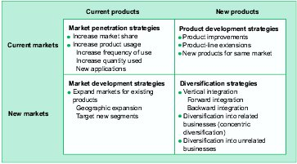
Alternative Corporate Growth Strategies

Slide 18
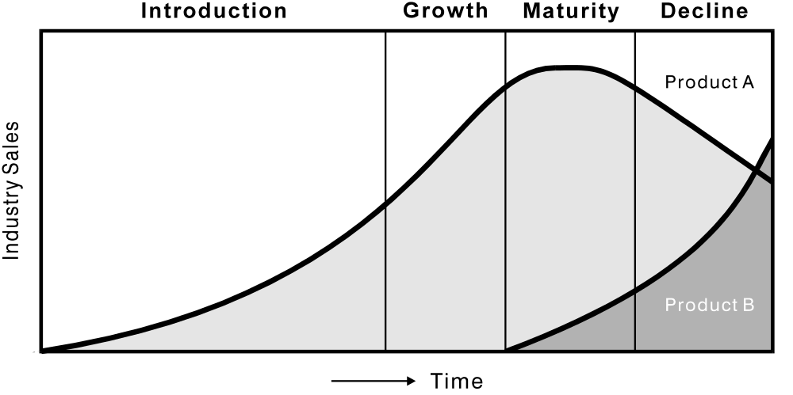
The Product Life Cycle

Slide 19
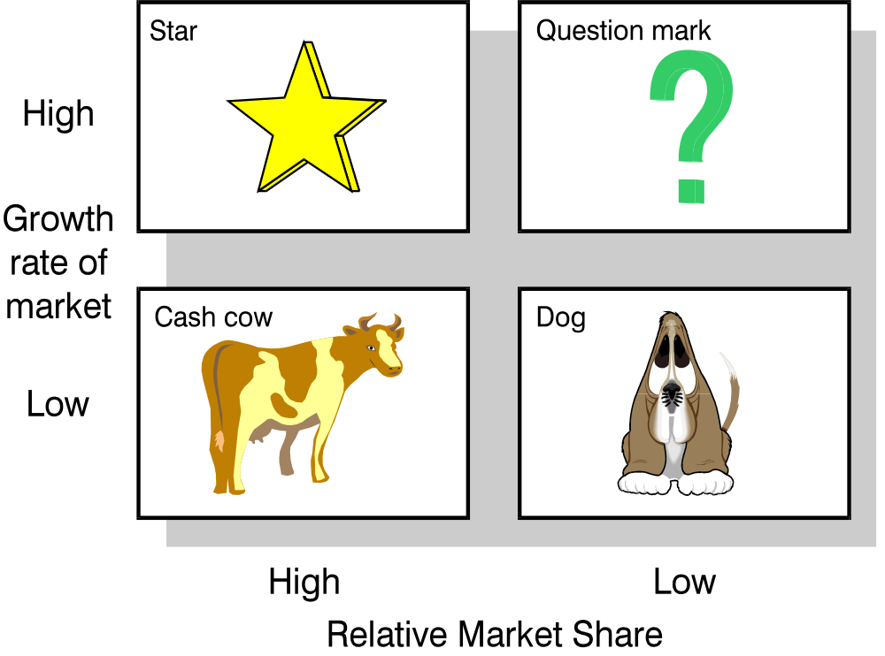
The Boston Box

Slide 20
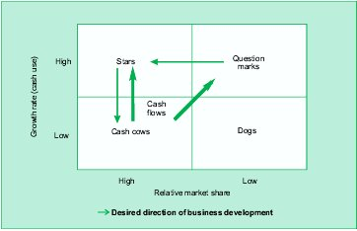
Cash Flows

Slide 21
Industry attractiveness–business position matrix
Select factors most appropriate for the firm and weight them according to their relative importance.
Then rate each business and its industry on the two sets of factors.
Next, combine the weighted evaluations into summary measures used to place
each business within one of the nine boxes in the matrix.

Slide 22
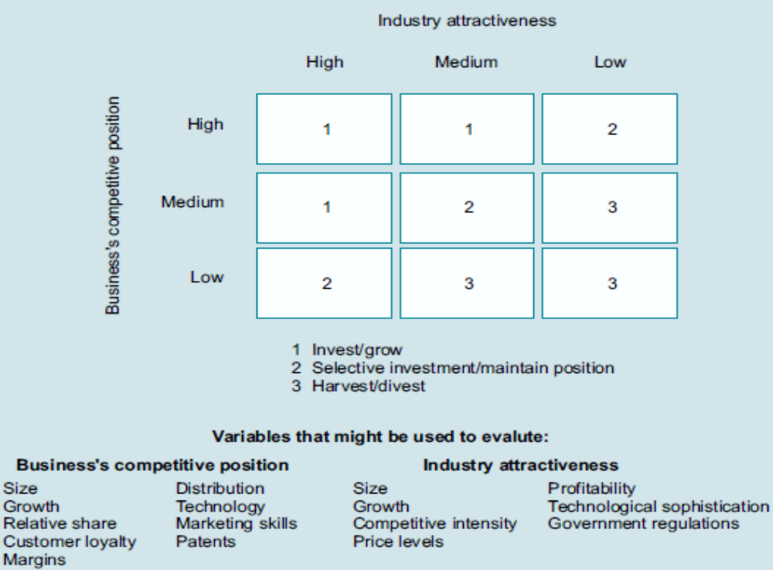
Industry attractiveness–business position matrix

Slide 23
Industry attractiveness–business position matrix
Businesses falling into boxes numbered 1 (where both industry attractiveness and the business’s ability to compete are relatively high) are good candidates for further investment for future growth.
Businesses in the 2 boxes should receive only selective investment with an objective of maintaining current position.
Finally, businesses in the 3 boxes are
candidates for harvesting or divestiture.

Slide 24
Value-based planning
Value-based planning is a resource allocation tool that attempts to address such questions by assessing the shareholder value a given strategy is likely to create.
Thus, value-based planning provides a basis for comparing the economic returns to be gained from investing in different businesses pursuing different strategies or from alternative strategies that might be adopted by a given business unit.

Slide 25
Features of Value-based planning
First, they assess the economic value a strategy is likely to produce by examining the cash flows it will generate, rather than relying on distorted accounting measures (e.g return on investment).
Second, they estimate the shareholder value that a strategy will produce by discounting its forecasted cash flows by the business’s risk-adjusted cost of capital.
Finally, they evaluate strategies based on the likelihood that the investments required by a strategy will deliver returns greater than the cost of capital that is referred to as its economic value added, or EVA.

Slide 26
Discounted Cash Flow Model
Shareholder value created by a strategy is determined by the cash flow it generates, the business’s cost of capital (which is used to discount future cash flows back to their present value) and the market value of the debt assigned to the business.

Slide 27
Discounted Cash Flow Model
The future cash flows generated by the strategy are, in turn, affected by six ‘value drivers’ :
the rate of sales growth the strategy will produce,
the operating profit margin,
the income tax rate,
investment in working capital,
fixed capital investment required by the strategy, and
the duration of value growth.

Slide 28
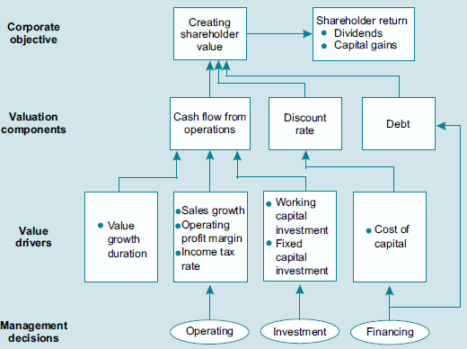
Discounted Cash Flow Model

